Slide 1

CLASS 3 CD-404 EVOLUTION OF DATA SCIENCE UNIT I
EVOLUTION OF DATA SCIENCE
Prof. Vineeta Shrivastava
Assistant Professor
Department of Computer Science & Engineering
LNCT-E, Bhopal
Lakshmi Narain College of Technology Excellence, Bhopal

Slide 2
CLASS 3 CD-404 EVOLUTION OF DATA SCIENCE UNIT I
AGENDA
Evolution of data science
Historical Overview
Key Milestones
Trends Shaping Data Science
Advancements in Technology
Impact on Industries
Future Directions
Prof. Vineeta Shrivastava
Assistant Professor
Department of Computer Science & Engineering
LNCT-E, Bhopal
Lakshmi Narain College of Technology Excellence, Bhopal

Slide 3
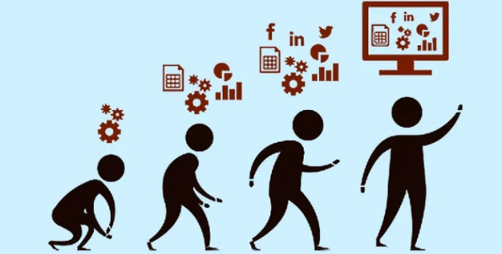
CLASS 3 CD-404 EVOLUTION OF DATA SCIENCE UNIT I
Evolution of data science
Early Data Analysis
Emergence of Statistics
Pre-Computer Era
Emergence of Computers and Databases
Statistical Methods in the 20th Century
Rise of AI & Machine Learning
Big Data Era
Prof. Vineeta Shrivastava
Assistant Professor
Department of Computer Science & Engineering
LNCT-E, Bhopal
Lakshmi Narain College of Technology Excellence, Bhopal

Slide 4
CLASS 3 CD-404 EVOLUTION OF DATA SCIENCE UNIT I
Evolution of data science
Open Source Tools
Cloud Computing
Internet of Things (IoT)
Artificial Intelligence (AI) and Machine Learning (ML)
Evolution of Data Storage
Prof. Vineeta Shrivastava
Assistant Professor
Department of Computer Science & Engineering
LNCT-E, Bhopal
Lakshmi Narain College of Technology Excellence, Bhopal

Slide 5
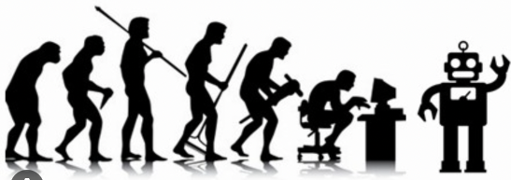
CLASS 3 CD-404 EVOLUTION OF DATA SCIENCE UNIT I
Evolution of data science
Parallel Processing and Distributed Computing
Development of Advanced Algorithms
Deep Learning and Neural Networks
Data Science in Industries
Prof. Vineeta Shrivastava
Assistant Professor
Department of Computer Science & Engineering
LNCT-E, Bhopal
Lakshmi Narain College of Technology Excellence, Bhopal

Slide 6
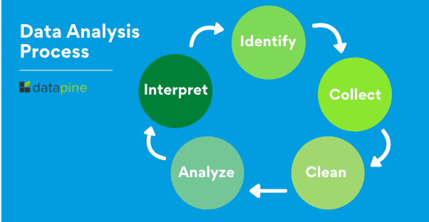
CLASS 3 CD-404 EVOLUTION OF DATA SCIENCE UNIT I
Historical Overview
Early Data Analysis Methods
Prof. Vineeta Shrivastava
Assistant Professor
Department of Computer Science & Engineering
LNCT-E, Bhopal
Lakshmi Narain College of Technology Excellence, Bhopal

Slide 7
CLASS 3 CD-404 EVOLUTION OF DATA SCIENCE UNIT I
Historical Overview
Early Data Analysis Methods
Early data analysis methods in data science were characterized by simpler statistical techniques and manual approaches.
Traditional data is normally structured data that's organized in records, files, and tables. Fields in traditional data sets are relational, so it's possible to work out their relationship and manipulate the data accordingly.
Prof. Vineeta Shrivastava
Assistant Professor
Department of Computer Science & Engineering
LNCT-E, Bhopal
Lakshmi Narain College of Technology Excellence, Bhopal

Slide 8
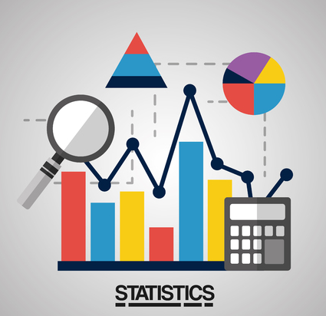
CLASS 3 CD-404 EVOLUTION OF DATA SCIENCE UNIT I
Historical Overview
2. Emergence of Statistics
Prof. Vineeta Shrivastava
Assistant Professor
Department of Computer Science & Engineering
LNCT-E, Bhopal
Lakshmi Narain College of Technology Excellence, Bhopal

Slide 9
CLASS 3 CD-404 EVOLUTION OF DATA SCIENCE UNIT I
Historical Overview
Emergence of Statistics
The emergence of statistics as a formal discipline can be traced back to the 17th century when scholars began to recognize the need for systematic methods to analyse data and draw meaningful inferences.
The emergence of statistics was closely linked to the rise of the scientific method and the increasing need to make sense of observational and experimental data.
Prof. Vineeta Shrivastava
Assistant Professor
Department of Computer Science & Engineering
LNCT-E, Bhopal
Lakshmi Narain College of Technology Excellence, Bhopal

Slide 10
CLASS 3 CD-404 EVOLUTION OF DATA SCIENCE UNIT I
Historical Overview
Emergence of Statistics
Statistics provided a systematic framework for collecting, organizing, summarizing, analysing, interpreting, and drawing conclusions from data.
As the discipline evolved, it became an essential tool in various fields, including biology, economics, sociology, and psychology.
Prof. Vineeta Shrivastava
Assistant Professor
Department of Computer Science & Engineering
LNCT-E, Bhopal
Lakshmi Narain College of Technology Excellence, Bhopal

Slide 11
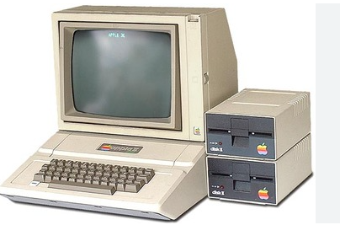
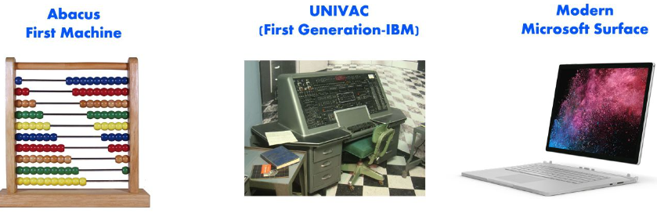
CLASS 3 CD-404 EVOLUTION OF DATA SCIENCE UNIT I
Historical Overview
3. Pre-Computer Era
Prof. Vineeta Shrivastava
Assistant Professor
Department of Computer Science & Engineering
LNCT-E, Bhopal
Lakshmi Narain College of Technology Excellence, Bhopal

Slide 12
CLASS 3 CD-404 EVOLUTION OF DATA SCIENCE UNIT I
Historical Overview
3. Pre-Computer Era
The pre-computer era in data science refers to a time when data analysis and statistical methods were primarily conducted through manual and mathematical processes.
Prof. Vineeta Shrivastava
Assistant Professor
Department of Computer Science & Engineering
LNCT-E, Bhopal
Lakshmi Narain College of Technology Excellence, Bhopal

Slide 13
CLASS 3 CD-404 EVOLUTION OF DATA SCIENCE UNIT I
Historical Overview
3. Pre-Computer Era
During the pre-computer era, data analysis relied heavily on manual methods, where statisticians and analysts performed calculations by hand or using simple mechanical devices.
Techniques such as manual sampling, graphical representation of data through charts and graphs, and basic statistical methods like mean and median calculations were employed.
Prof. Vineeta Shrivastava
Assistant Professor
Department of Computer Science & Engineering
LNCT-E, Bhopal
Lakshmi Narain College of Technology Excellence, Bhopal

Slide 14
CLASS 3 CD-404 EVOLUTION OF DATA SCIENCE UNIT I
Historical Overview
3. Pre-Computer Era
The analysis of data was often constrained by the limitations of manual computation, making it challenging to handle large datasets or complex statistical models.
Prof. Vineeta Shrivastava
Assistant Professor
Department of Computer Science & Engineering
LNCT-E, Bhopal
Lakshmi Narain College of Technology Excellence, Bhopal

Slide 15
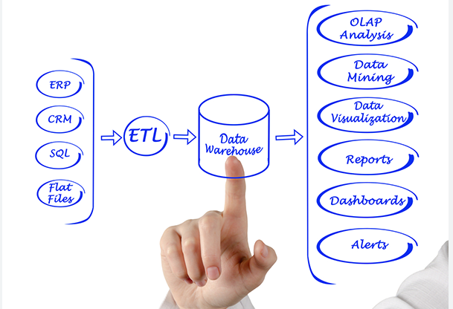
CLASS 3 CD-404 EVOLUTION OF DATA SCIENCE UNIT I
4. Development of Computers and Databases
Prof. Vineeta Shrivastava
Assistant Professor
Department of Computer Science & Engineering
LNCT-E, Bhopal
Lakshmi Narain College of Technology Excellence, Bhopal

Slide 16
CLASS 3 CD-404 EVOLUTION OF DATA SCIENCE UNIT I
Key Milestones
4. Development of Computers and Databases The development of computers and databases marked a transformative period in the history of data science, providing the tools and infrastructure necessary for the systematic storage, retrieval, and analysis of large volumes of data.
Prof. Vineeta Shrivastava
Assistant Professor
Department of Computer Science & Engineering
LNCT-E, Bhopal
Lakshmi Narain College of Technology Excellence, Bhopal

Slide 17
CLASS 3 CD-404 EVOLUTION OF DATA SCIENCE UNIT I
Key Milestones
4. Development of Computers and Databases Early Computers and Punch Card
Database Management Systems (DBMS)
Relational Databases
Evolution of Storage Media
Integration with Data Science
Prof. Vineeta Shrivastava
Assistant Professor
Department of Computer Science & Engineering
LNCT-E, Bhopal
Lakshmi Narain College of Technology Excellence, Bhopal

Slide 18
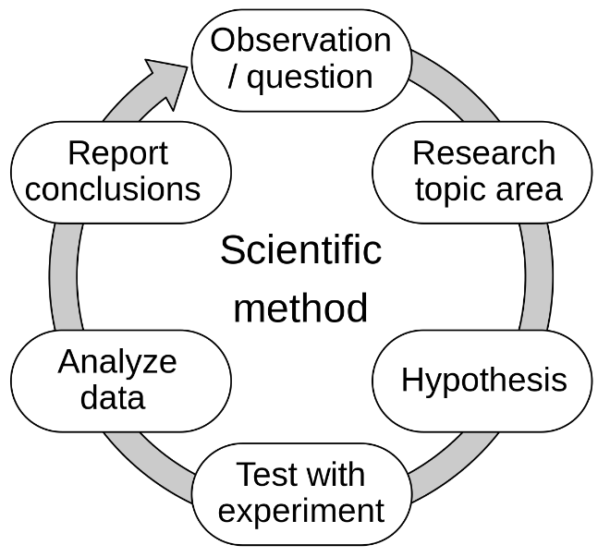
CLASS 3 CD-404 EVOLUTION OF DATA SCIENCE UNIT I
5. Statistical Methods in the 20th Century
Prof. Vineeta Shrivastava
Assistant Professor
Department of Computer Science & Engineering
LNCT-E, Bhopal
Lakshmi Narain College of Technology Excellence, Bhopal

Slide 19
CLASS 3 CD-404 EVOLUTION OF DATA SCIENCE UNIT I
Key Milestones
5. Statistical Methods in the 20th Century
The 20th century was a period of significant advancement in statistical methods, with key developments shaping the way data was analysed and interpreted. Statisticians during this time built upon the foundations laid in previous centuries and made substantial contributions to both theoretical and applied statistics.
Prof. Vineeta Shrivastava
Assistant Professor
Department of Computer Science & Engineering
LNCT-E, Bhopal
Lakshmi Narain College of Technology Excellence, Bhopal

Slide 20
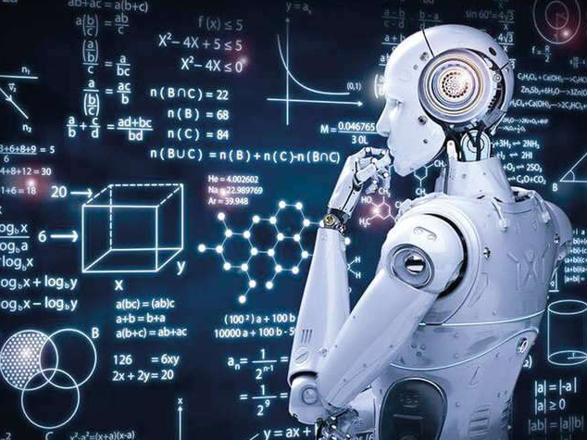
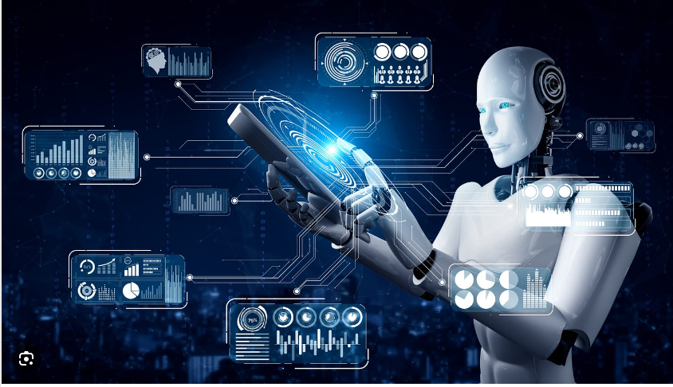
CLASS 3 CD-404 EVOLUTION OF DATA SCIENCE UNIT I
6. Rise of AI & Machine Learning
Prof. Vineeta Shrivastava
Assistant Professor
Department of Computer Science & Engineering
LNCT-E, Bhopal
Lakshmi Narain College of Technology Excellence, Bhopal

Slide 21
CLASS 3 CD-404 EVOLUTION OF DATA SCIENCE UNIT I
Key Milestones
6. Rise of AI & Machine Learning
The emergence of machine learning (ML) represents a significant paradigm shift in the field of data science, transforming the way computers learn from data to make predictions or decisions without explicit programming. While the roots of machine learning can be traced back to early concepts, its formalization and widespread adoption began to take shape in the mid-20th century.
Prof. Vineeta Shrivastava
Assistant Professor
Department of Computer Science & Engineering
LNCT-E, Bhopal
Lakshmi Narain College of Technology Excellence, Bhopal

Slide 22
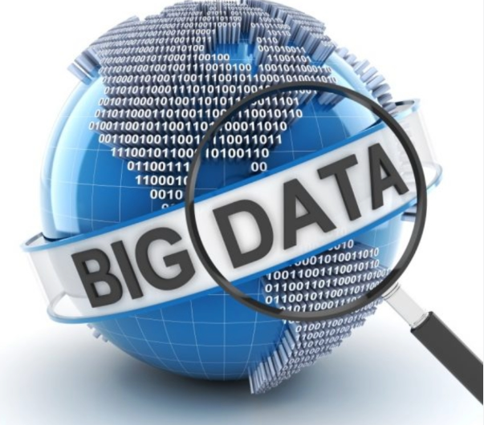
CLASS 3 CD-404 EVOLUTION OF DATA SCIENCE UNIT I
7. Big Data ERA
Prof. Vineeta Shrivastava
Assistant Professor
Department of Computer Science & Engineering
LNCT-E, Bhopal
Lakshmi Narain College of Technology Excellence, Bhopal

Slide 23
CLASS 3 CD-404 EVOLUTION OF DATA SCIENCE UNIT I
Key Milestones
7. Big Data ERA
The term big data has been in use since the 1990s, with some giving credit to John Mashey for popularizing the term.
Big data usually includes data sets with sizes beyond the ability of commonly used software tools to capture, curate, manage, and process data within a tolerable elapsed time.
Prof. Vineeta Shrivastava
Assistant Professor
Department of Computer Science & Engineering
LNCT-E, Bhopal
Lakshmi Narain College of Technology Excellence, Bhopal

Slide 24
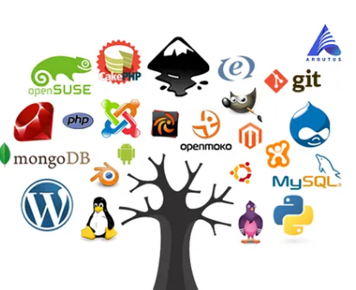
CLASS 3 CD-404 EVOLUTION OF DATA SCIENCE UNIT I
8. Open Source Tools
Prof. Vineeta Shrivastava
Assistant Professor
Department of Computer Science & Engineering
LNCT-E, Bhopal
Lakshmi Narain College of Technology Excellence, Bhopal

Slide 25

CLASS 3 CD-404 EVOLUTION OF DATA SCIENCE UNIT I
Key Milestones
8. Open Source Tools
Open source software (OSS) is software that is distributed with its source code, making it available for use, modification, and distribution with its original rights.
Prof. Vineeta Shrivastava
Assistant Professor
Department of Computer Science & Engineering
LNCT-E, Bhopal
Lakshmi Narain College of Technology Excellence, Bhopal

Slide 26

CLASS 3 CD-404 EVOLUTION OF DATA SCIENCE UNIT I
9. Cloud Computing
Prof. Vineeta Shrivastava
Assistant Professor
Department of Computer Science & Engineering
LNCT-E, Bhopal
Lakshmi Narain College of Technology Excellence, Bhopal

Slide 27
CLASS 3 CD-404 EVOLUTION OF DATA SCIENCE UNIT I
Key Milestones
9. Cloud Computing
Cloud computing is the delivery of computing services—including servers, storage, databases, networking, software, analytics, and intelligence—over the internet (“the cloud”) to offer faster innovation, flexible resources.
Data sciences involves analysing data, while cloud computing involves storing and processing data.
Prof. Vineeta Shrivastava
Assistant Professor
Department of Computer Science & Engineering
LNCT-E, Bhopal
Lakshmi Narain College of Technology Excellence, Bhopal

Slide 28

CLASS 3 CD-404 EVOLUTION OF DATA SCIENCE UNIT I
10. IOT
Prof. Vineeta Shrivastava
Assistant Professor
Department of Computer Science & Engineering
LNCT-E, Bhopal
Lakshmi Narain College of Technology Excellence, Bhopal

Slide 29
CLASS 3 CD-404 EVOLUTION OF DATA SCIENCE UNIT I
Key Milestones
10. IOT
The Internet of Things (IoT) describes the network of physical objects “things” that are embedded with sensors, software, and other technologies for the purpose of connecting and exchanging data with other devices and systems over the internet.
Prof. Vineeta Shrivastava
Assistant Professor
Department of Computer Science & Engineering
LNCT-E, Bhopal
Lakshmi Narain College of Technology Excellence, Bhopal

Slide 30
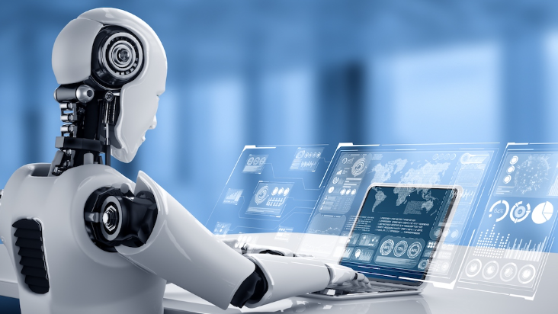
CLASS 3 CD-404 EVOLUTION OF DATA SCIENCE UNIT I
11. Artificial Intelligence & Machine Learning
Prof. Vineeta Shrivastava
Assistant Professor
Department of Computer Science & Engineering
LNCT-E, Bhopal
Lakshmi Narain College of Technology Excellence, Bhopal

Slide 31
CLASS 3 CD-404 EVOLUTION OF DATA SCIENCE UNIT I
Key Milestones
11. Artificial Intelligence & Machine Learning
Artificial intelligence refers to the general ability of computers to emulate human thought and perform tasks in real-world environments, while machine learning refers to the technologies and algorithms that enable systems to identify patterns, make decisions, and improve themselves through experience.
Prof. Vineeta Shrivastava
Assistant Professor
Department of Computer Science & Engineering
LNCT-E, Bhopal
Lakshmi Narain College of Technology Excellence, Bhopal

Slide 32

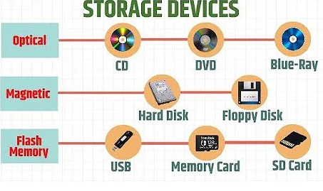
CLASS 3 CD-404 EVOLUTION OF DATA SCIENCE UNIT I
12. Evolution of data Storage
Prof. Vineeta Shrivastava
Assistant Professor
Department of Computer Science & Engineering
LNCT-E, Bhopal
Lakshmi Narain College of Technology Excellence, Bhopal

Slide 33
CLASS 3 CD-404 EVOLUTION OF DATA SCIENCE UNIT I
Key Milestones
12. Evolution of data Storage
The evolution of storage technologies in data centers has been remarkable, from the first HDDs in the 1950s to the cutting-edge SSDs and hybrid arrays of today.
As data centers continue to play a vital role in our digital age, businesses need reliable and efficient solutions to stay ahead.
Prof. Vineeta Shrivastava
Assistant Professor
Department of Computer Science & Engineering
LNCT-E, Bhopal
Lakshmi Narain College of Technology Excellence, Bhopal

Slide 34
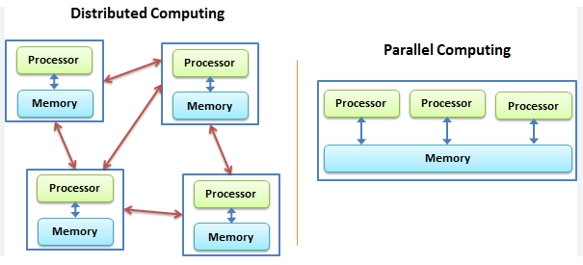
CLASS 3 CD-404 EVOLUTION OF DATA SCIENCE UNIT I
13. Parallel Processing and Distributed Computing
Prof. Vineeta Shrivastava
Assistant Professor
Department of Computer Science & Engineering
LNCT-E, Bhopal
Lakshmi Narain College of Technology Excellence, Bhopal

Slide 35
CLASS 3 CD-404 EVOLUTION OF DATA SCIENCE UNIT I
Key Milestones
13. Parallel processing and distributed computing
In parallel computing, all processors share the same memory and the processors communicate with each other with the help of this shared memory.
Distributed computing systems, on the other hand, have their own memory and processors.
Prof. Vineeta Shrivastava
Assistant Professor
Department of Computer Science & Engineering
LNCT-E, Bhopal
Lakshmi Narain College of Technology Excellence, Bhopal

Slide 36

CLASS 3 CD-404 EVOLUTION OF DATA SCIENCE UNIT I
14. Development of Advance Algorithms
Prof. Vineeta Shrivastava
Assistant Professor
Department of Computer Science & Engineering
LNCT-E, Bhopal
Lakshmi Narain College of Technology Excellence, Bhopal

Slide 37
CLASS 3 CD-404 EVOLUTION OF DATA SCIENCE UNIT I
14. Development of Advance Algorithms
Advanced Data structures are one of the essential branches of data science which is used for storage, organization and management of data and information for efficient, easy accessibility and modification of data. They are the basic element for creating efficient and effective software design and algorithms.
They include graph algorithms, linear programming, Fourier transforms, string algorithms, randomized algorithms, geometric algorithms and such others.
Prof. Vineeta Shrivastava
Assistant Professor
Department of Computer Science & Engineering
LNCT-E, Bhopal
Lakshmi Narain College of Technology Excellence, Bhopal

Slide 38
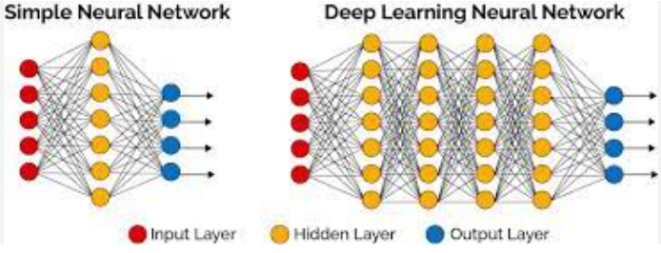
CLASS 3 CD-404 EVOLUTION OF DATA SCIENCE UNIT I
15. Deep Learning & Neural Networks
Prof. Vineeta Shrivastava
Assistant Professor
Department of Computer Science & Engineering
LNCT-E, Bhopal
Lakshmi Narain College of Technology Excellence, Bhopal

Slide 39
CLASS 3 CD-404 EVOLUTION OF DATA SCIENCE UNIT I
Key Milestones
15. Deep Learning & Neural Networks
A neural network is a method in artificial intelligence that teaches computers to process data in a way that is inspired by the human brain.
It is a type of machine learning process, called deep learning, that uses interconnected nodes or neurons in a layered structure that resembles the human brain.
Prof. Vineeta Shrivastava
Assistant Professor
Department of Computer Science & Engineering
LNCT-E, Bhopal
Lakshmi Narain College of Technology Excellence, Bhopal

Slide 40
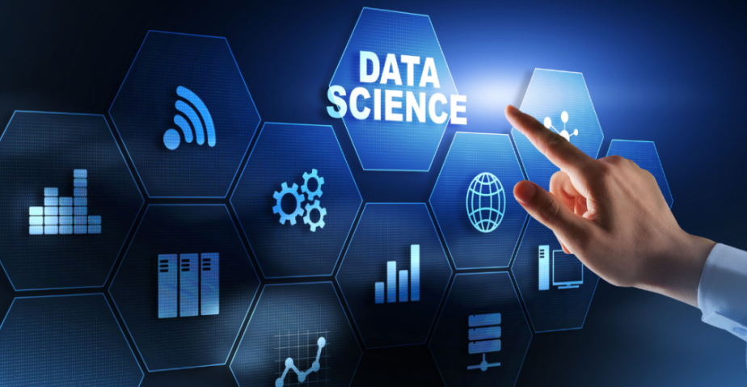
CLASS 3 CD-404 EVOLUTION OF DATA SCIENCE UNIT I
16. Data Science in Industries
Prof. Vineeta Shrivastava
Assistant Professor
Department of Computer Science & Engineering
LNCT-E, Bhopal
Lakshmi Narain College of Technology Excellence, Bhopal

Slide 41
CLASS 3 CD-404 EVOLUTION OF DATA SCIENCE UNIT I
Key Milestones
16. Data Science in Industries
Improving Production and Distribution Efficiencies - The use of data science tools like ML and predictive algorithms can speed up production time, avoid processing delays, and schedule preventative maintenance.
Prof. Vineeta Shrivastava
Assistant Professor
Department of Computer Science & Engineering
LNCT-E, Bhopal
Lakshmi Narain College of Technology Excellence, Bhopal

Slide 42
CLASS 3 CD-404 EVOLUTION OF DATA SCIENCE UNIT I
Trends Shaping Data Science
Several trends were shaping the field of data science. Keep in mind that the field evolves rapidly, and newer trends may have emerged.
AI and Machine Learning Integration
Explainable AI (XAI)
Automated Machine Learning (AutoML)
Natural Language Processing (NLP) Advancements
Edge Computing for Data Processing
Responsible AI
Prof. Vineeta Shrivastava
Assistant Professor
Department of Computer Science & Engineering
LNCT-E, Bhopal
Lakshmi Narain College of Technology Excellence, Bhopal

Slide 43
CLASS 3 CD-404 EVOLUTION OF DATA SCIENCE UNIT I
Advancements in Technology
Advancements in technology have significantly propelled the field of data science, revolutionizing the way data is collected, processed, and analyzed.
The advent of high-performance computing systems, cloud infrastructure, and distributed computing frameworks has empowered data scientists to tackle complex problems on an remarkable scale.
Prof. Vineeta Shrivastava
Assistant Professor
Department of Computer Science & Engineering
LNCT-E, Bhopal
Lakshmi Narain College of Technology Excellence, Bhopal

Slide 44
CLASS 3 CD-404 EVOLUTION OF DATA SCIENCE UNIT I
Advancements in Technology
The evolution of big data technologies, such as Apache Hadoop and Apache Spark, has enabled the efficient processing of massive datasets, facilitating insights into patterns and trends that were previously challenging to discern.
Prof. Vineeta Shrivastava
Assistant Professor
Department of Computer Science & Engineering
LNCT-E, Bhopal
Lakshmi Narain College of Technology Excellence, Bhopal

Slide 45
CLASS 3 CD-404 EVOLUTION OF DATA SCIENCE UNIT I
Impact on Industries
The evolution of data science has had a profound impact on various industries, transforming the way organizations operate, make decisions, and derive insights from data.
Healthcare
Finance
Retail and E-Commerce
Prof. Vineeta Shrivastava
Assistant Professor
Department of Computer Science & Engineering
LNCT-E, Bhopal
Lakshmi Narain College of Technology Excellence, Bhopal

Slide 46
CLASS 3 CD-404 EVOLUTION OF DATA SCIENCE UNIT I
Impact on Industries
The impact of data science on industries is pervasive, fostering innovation, efficiency, and strategic decision-making.
As organizations continue to leverage data science, the potential for transformative advancements across diverse sectors remains significant.
The evolving landscape of data science continues to shape the way industries operate and adapt in an increasingly data-driven world.
Prof. Vineeta Shrivastava
Assistant Professor
Department of Computer Science & Engineering
LNCT-E, Bhopal
Lakshmi Narain College of Technology Excellence, Bhopal

Slide 47
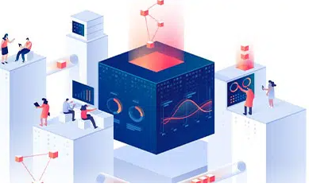
CLASS 3 CD-404 EVOLUTION OF DATA SCIENCE UNIT I
Future Directions
The future directions of data science hold exciting prospects as the field continues to evolve with technological advancements and societal needs.
Explainable AI (XAI) is likely to gain prominence, addressing the interpretability of complex machine learning models and ensuring transparency in decision-making.
Prof. Vineeta Shrivastava
Assistant Professor
Department of Computer Science & Engineering
LNCT-E, Bhopal
Lakshmi Narain College of Technology Excellence, Bhopal

Slide 48
CLASS 3 CD-404 EVOLUTION OF DATA SCIENCE UNIT I
Future Directions
The integration of data science with emerging technologies, such as quantum computing, may unlock new possibilities for solving computationally intensive problems.
Continued advancements in natural language processing (NLP) and language models could lead to more sophisticated and context-aware AI systems, impacting areas like conversational AI and language translation.
Prof. Vineeta Shrivastava
Assistant Professor
Department of Computer Science & Engineering
LNCT-E, Bhopal
Lakshmi Narain College of Technology Excellence, Bhopal

Slide 49
CLASS 3 CD-404 EVOLUTION OF DATA SCIENCE UNIT I
THANKYOU
Prof. Vineeta Shrivastava
Assistant Professor
Department of Computer Science & Engineering
LNCT-E, Bhopal
Lakshmi Narain College of Technology Excellence, Bhopal

